Slide 1
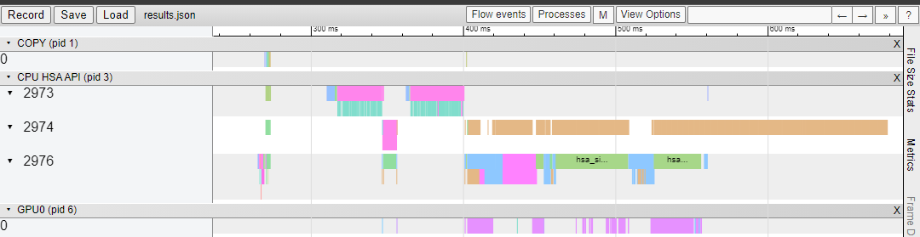
rocprof
Has-trace

Slide 2
rocprof
Has-trace
Prof 3 dim rocfft
6 kernels:
 | Forward | Durations(ns) | withonly | without
1 | fft_fwd_ip_len50 | 27,200 | 0.079ms | 0.178ms
2 | real_post_process | 31,840 | 0.083ms -> 0.073ms | 0.192ms
3 | fft_fwd_ip_len100 | 34,240 | 0.085ms | 0.174ms
4 | transpose_kernel2 | 23,360 | 0.101ms | 0.184ms
5 | fft_fwd_op_len100 | 33,920 | 0.089ms | 0.177ms
6 | transpose_kernel2 | 24,000 | - | -
 | Launch kernel | 56,000 | 0.056ms
 | total | 0.216ms

Slide 3
Weekly
 | Client Forward | Client Backward | Rocfft-rider fwd | Rocfft-rider bwd
09/11 | 0.324ms | 0.325ms
09/18 | 0.216ms | 0.216ms | 0.2926ms | 0.319ms
10/22 | 0.206ms
 | LDSBankConflict |  | MemUnitStalled
 | before | after | before | after
real_post_process_kernel_transpose | 24% | 0% | 19% | 10%
transpose_kernel2_scheme |  | 14% |  | 3%

Slide 4
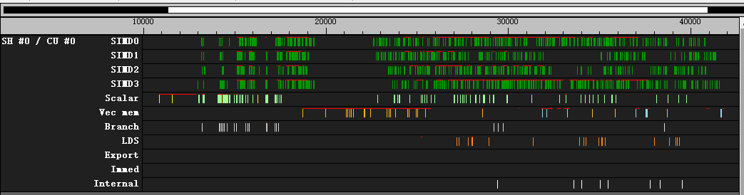
ttrace
Fft_fwd_ip_len50

Slide 5
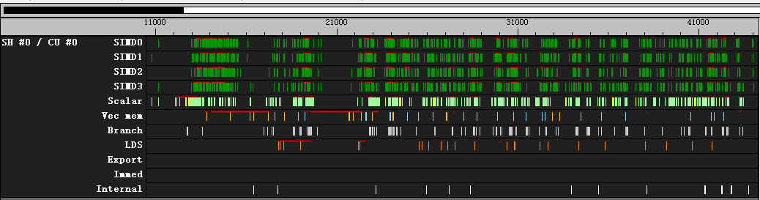
ttrace
Real_post_process_kernel_transpose

Slide 6
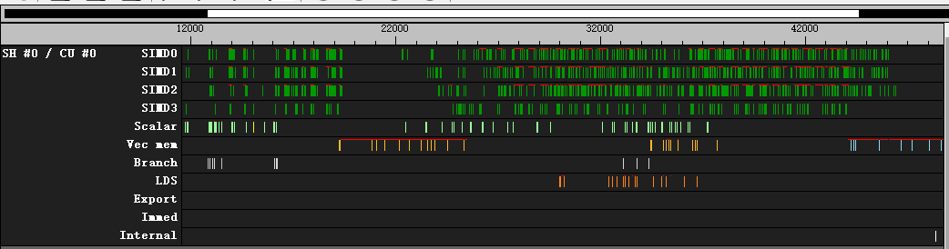
ttrace
Fft_fwd_ip_len100

Slide 7
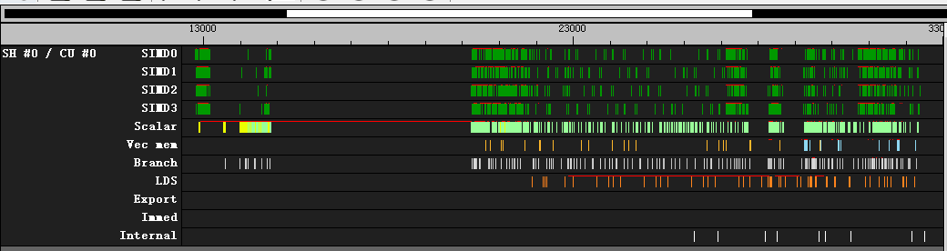
ttrace
transpose_kernel2_schemeI

Slide 8
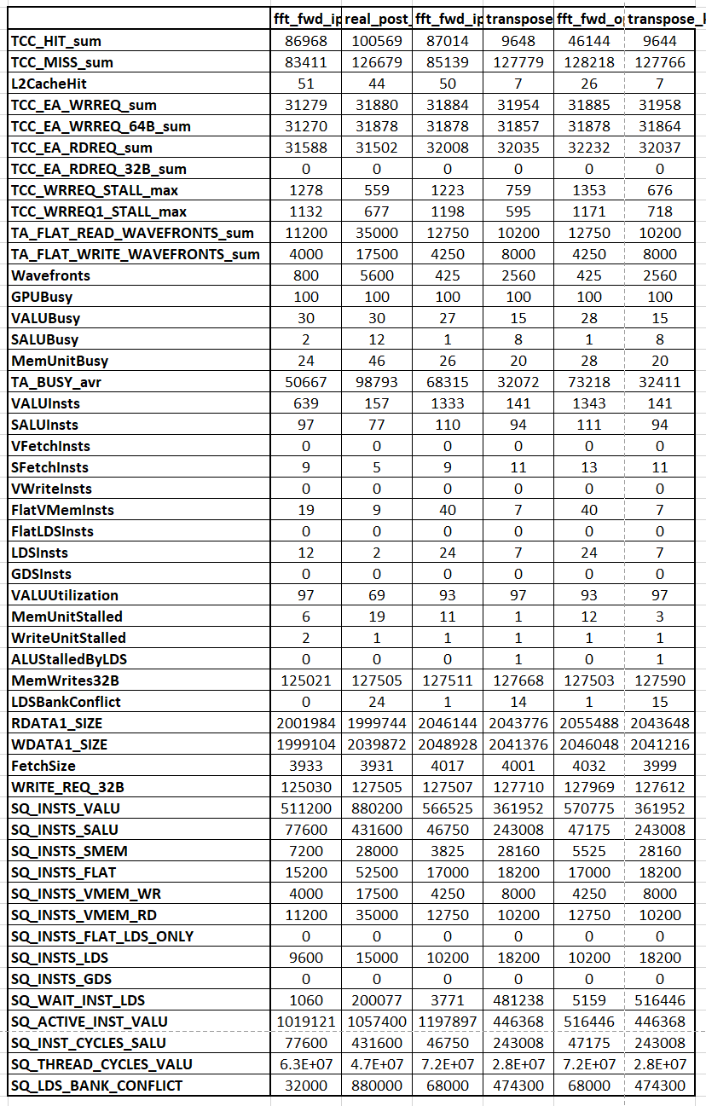
Perf counter
Origin data

Slide 9
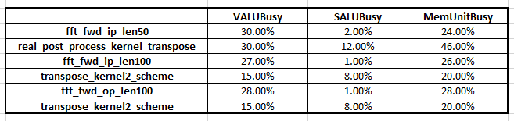
Perf counter
Busy time
For transpose kernel，memory busy > alu busy
For fft kernel, memory busy = alu busy
Memory limitation

Slide 10
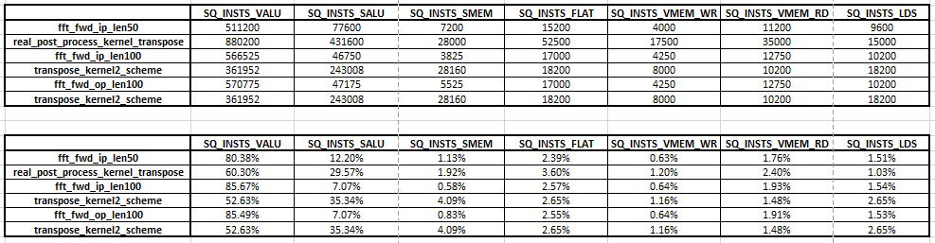
Perf counter
Issue instruction
Compare with pre-slides
Fft kernel issue 5%~6% mem instr, but cost 26%~28% gpu time
Transpose kernel issue 10% mem instr, cost 20% gpu time
Real post kernel issue 10% mem instr, cost 46% gpu time

Slide 11
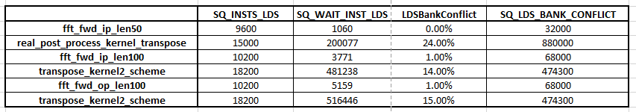
Perf counter
Lds bank conflict
Real_post_process_kernel: 24% lds time is conflict
For transpose kenrel: 15% LDS time is conflict

Slide 12
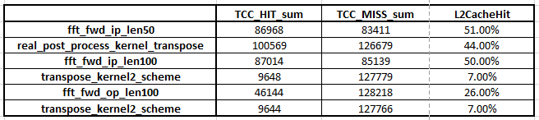
Perf counter
L2 hit rate
First 2 fft kernel has high hit rate (50%), while 3rd fft kernel has low hit rate (26%) ?

Slide 13
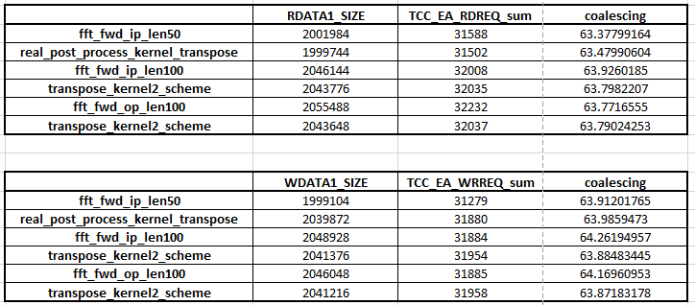
Perf counter
coalescing
All kernel have very good coalescing practice (cacheline usage 100%)

Slide 14
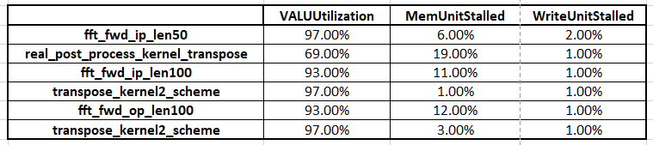
Perf counter
Mem stall
Real post kernel and fft100 kernel has above 10% stall time(channel conflict)

Slide 15
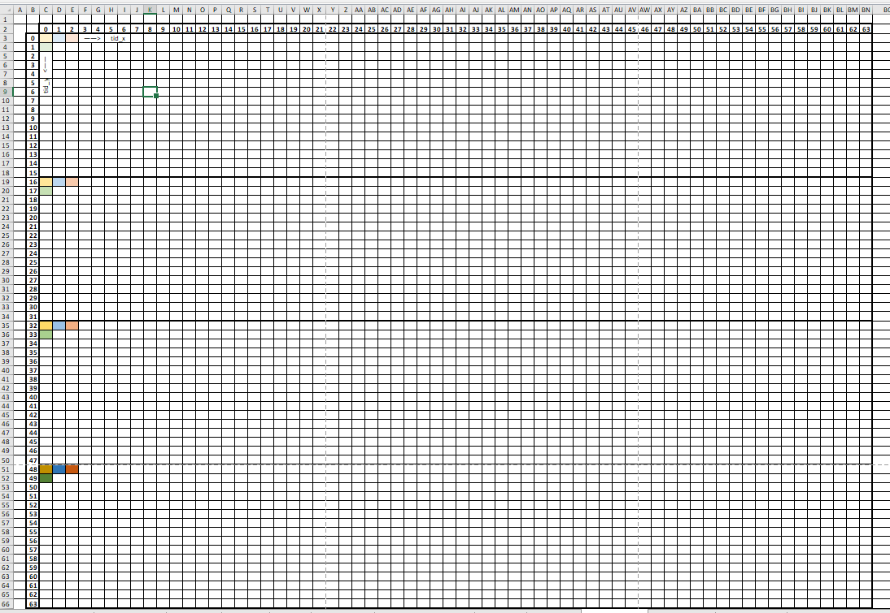
Perf counter
transpose
Tile transpose
Group size = 64 * 16
Tile = 64 * 64 float2
Transpose one tile per group
Process 4 float2 per thread
Bandwidth = 316.64GB/s vs 1024GB/s

Slide 16
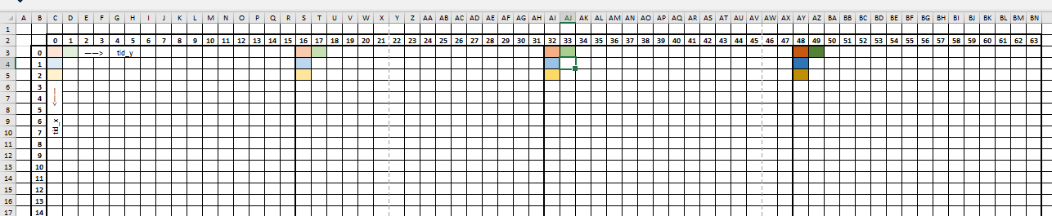
Perf counter
transpose
LDS usage
4096 float2 (32KB) per group
Write to lds has bank conflict
SQ_INSTS_LDS (18200)
SQ_WAIT_INST_LDS (412915)
SQ_LDS_BANK_CONFLICT (474300)
LDSBankConflict (16%)

Slide 17
Perf counter
transpose
Reduce bank conflict with padding
Pad one float2 every row (64 float2)
SQ_INSTS_LDS (18200)
SQ_WAIT_INST_LDS (926)
SQ_LDS_BANK_CONFLICT (0)
LDSBankConflict (0%)

Slide 18
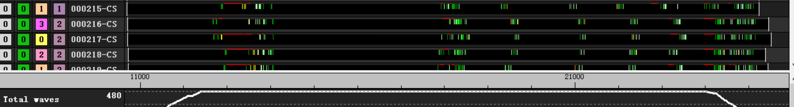
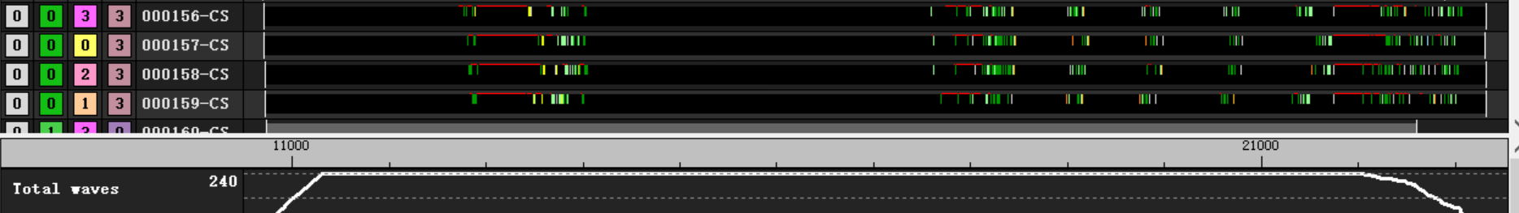
Perf counter
transpose
Reduce bank conflict with padding
Increase workgroup number
Improve only less than 200 clk

Slide 19
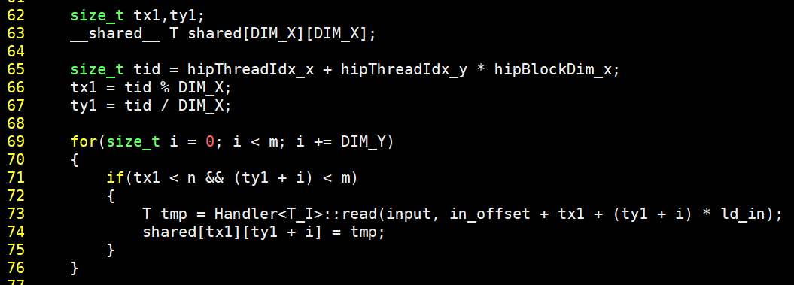
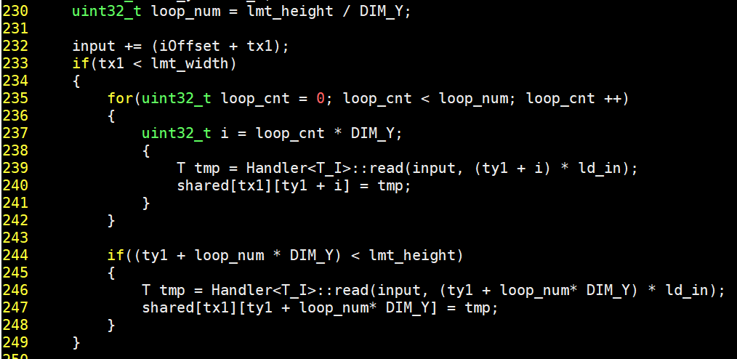
Perf counter
transpose
Reduce instruction

Slide 20
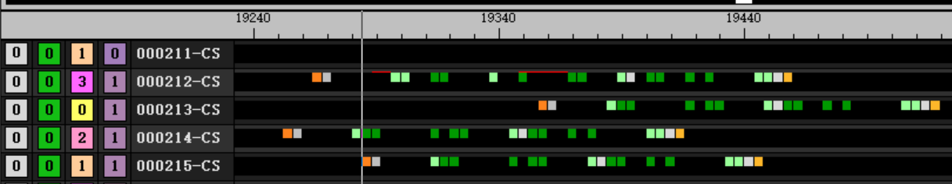
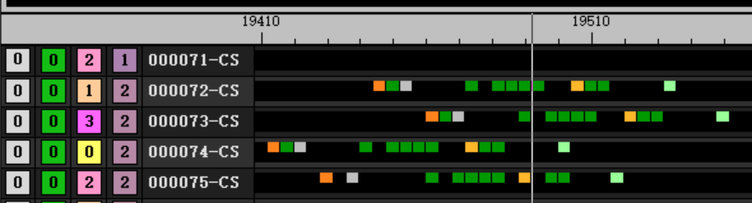
Perf counter
transpose
Reduce instruction
6salu + 9valu + 3branch → 1salu + 8valu + 1branch
196 clk → 92 clk

Slide 21
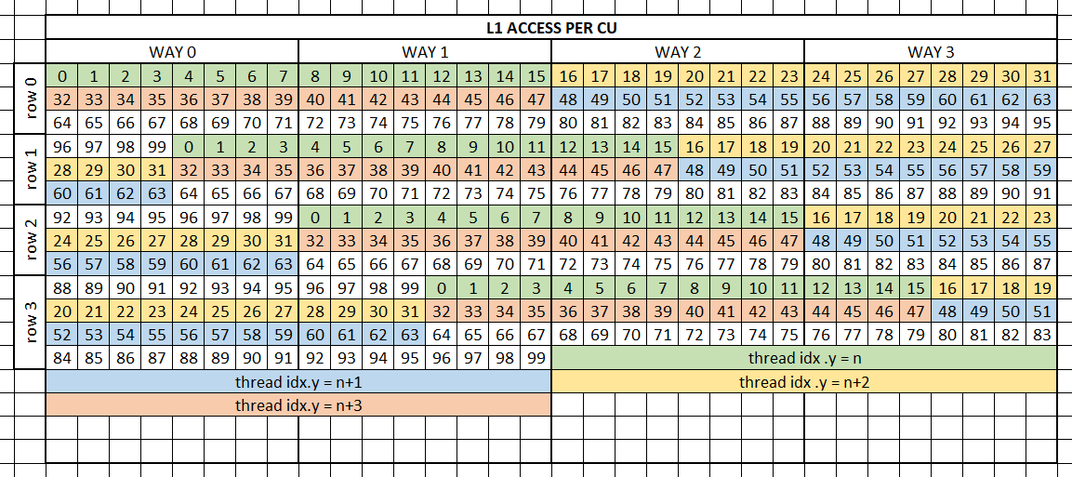
Perf counter
transpose
L1 access
Pattern
Each lane (16 threads) access one cacheline
Each wave (64 threads) access 4 entire cacheline

Slide 22
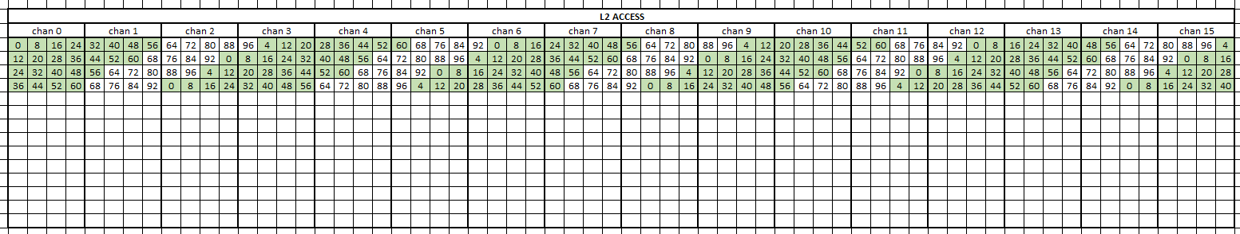
Perf counter
transpose
L2 access
Pattern
Each wave (64 threads) access 2 entire channel
No channel conflict
Transpose kernel has 3% memory stall.

Slide 23
Perf counter
Realcomplex_even_transpose
Tile transpose
n = 50, m = 100, dim = 3
group size = [16, 16, 1]
grid size = [2, 700, 1]
Tile = 16 * 16 float2
Len0 = 50
Tile_size = 16
Transpose one tile per group
Process 4 float2 per thread
Bandwidth = 316.64GB/s vs 1024GB/s

